Slide 1

All-Chat Forums
Ron Alexis / Joshua Alkins / Jason Charles
190904 / 190908 / 190906

Slide 2
Introduction
All-Chat is a complete messaging service which is within development. The application aims to be a major source of communication and sharing for the user. The application allows for messages to be sent from a respective chat room to others within the same chat room, with in its current development cycle the application is able to work regionally connecting thousands of users together to allow for mass communication

Slide 3

All Chat
This is the icon that greets users upon installation of the chat application, All-Chat Forums

Slide 4
Features
Login
Themes
Sounds
Notifications
Register Users
Create new chats
Join Chats
Storage Navigation
Send Messages
Maps
Icon
Copying
Internet Connectivity
Online Storage
Logout
File Sharing
Database Connectivity

Slide 5
Loading The App

Slide 6
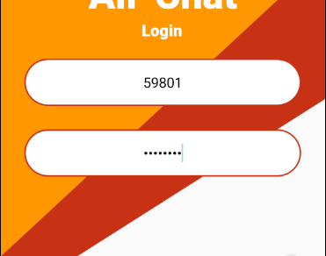
Login Screen
This is the first screen seen upon entry to the app
This page consist of three major elements :
Login
Register
Themes
Apart from them this page also boost quality of life actions to ensure smooth operation:
Field control
Sounds
Notification

Slide 7

Login
Login Screen is the first page that all users are greeted with. This page holds 3 major functions:
Login – a user can log into the application if an account exists. The user first enters their access code and their password, into their respective fields. Once filled, the login button will be enabled which would begin the process of the application confirming with cloud services that the user exists. Accurate information has been entered, before a user is granted access or a toast message/warning is displayed. If the user is granted access they will be moved to another Intent, a toast is to be displayed and an audible sound, a “ding” plays.

Slide 8
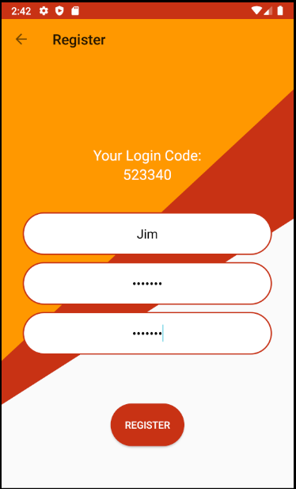
Register
This page allows for a new user to be created
Firstly, the user is firstly assigned a 6-digit user code
they are prompted to enter a username and a password
This page also employs some of the same quality of life actions as login

Slide 9
Register
Notes:
One of the main functionalities of the login page. If the user has downloaded the application and does not have a pre-existing account, they would not be able to log into the application. For a user to register for an account we have made it as simple as possible. When the user selects the register button, they are redirected to the register page, here is where they are given their access code and where they can set their password and username. When all fields have been filled the user will then be able to register. After this is completed the user will be signed into the chat application. Afterwards the user may use the login screen to access their account

Slide 10
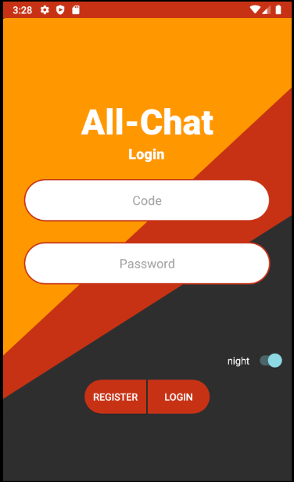
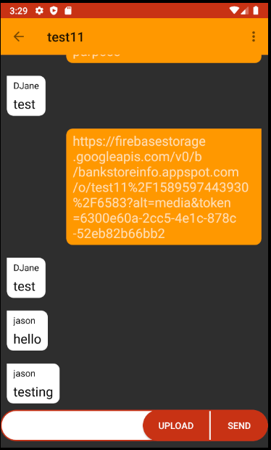
Theme
Themes are controlled via a switch on the login page causing switches from light to dark mode
The switch changes the theme for every intent of the application causing the background or text of some pages to change color

Slide 11
Themes
Notes:
Themes are controlled via the night switch which is on the login page. The switch updates the theme for all pages of the application. The application is by default in the light mode which sees more white being used with black text. When the switch is triggered, the backgrounds which were white will become black. but not in all cases, so in most cases. The same can be said for text where some black text becomes white or may change to a different color or remain black depending on their use.

Slide 12

Notification
Notes:
This what is displayed when a user logs into the application

Slide 13
Notifications
Notes:
When a user logs into their account it triggers 3 processes. one process which checks if the user information is correct and two other process which trigger when it is complete. One of these processes is an audio “ding” which can be heard upon access being granted. While the other is a process which displays a notification, welcoming the user.

Slide 14
Entering the App

Slide 15
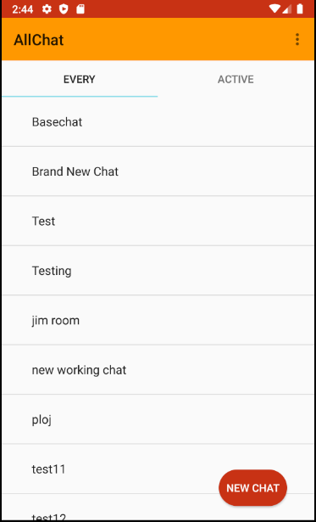
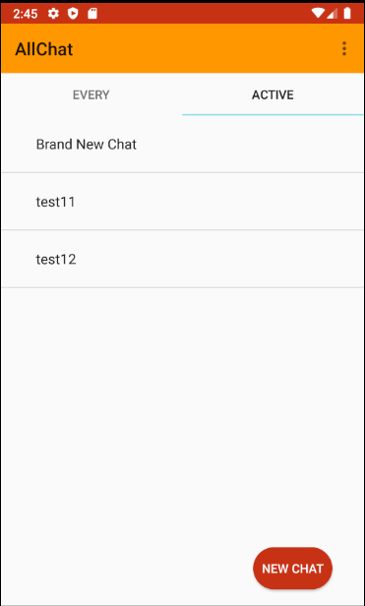
Chat Menu
This screen is seen after the user has ether been registered or logged in.
This page consist of three major elements :
Chat Select
Chat Creation
Logout

Slide 16
Chat Menu
Notes:
Chat Menu Consist of the two list which are displayed after a user logs in. “Every” is the chat which displays all chats which have been created and which the user can join by clicking the name of the chat that is being displayed. While “Active” is the chat that displays the chats that the user has visited before and is likely to use again. For Active Chats it is ordered by the most recent chat used. These two list ensures that the user can see all chats that are offered and see the chats which they are most interested in.

Slide 17
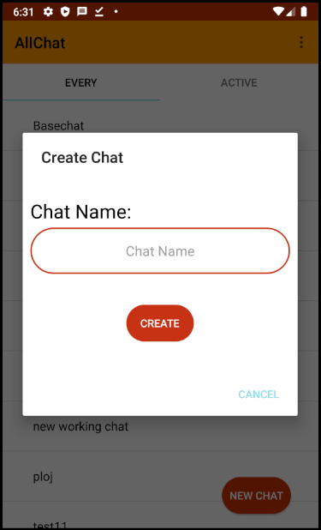
Create Chat
To create a chat the user must be logged into the application and select the new chat button which is displayed in the chat menu page

Slide 18
Create Chat
Notes:
When the user wants to create a chat the occurence is :
The user must be logged into their account
Navigate to the bottom right corner of the chat menu page selecting “new chat”
A dialog will then appear where the user can enter the desired name of the chat which he would want to create
Once these steps are done the user and any user that sees these chat may participate in discussion and sharing links

Slide 19
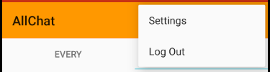
Logout
This option is displayed on every page after the user has logged in and can be accessed by click the 3 dots icon/ hamburger button
Notes:
When the user is finished with the application, they can logout of the chat to ensure that no one can pretend to be them sending messages inside of the different chats . The option can be selected from any page after the log in screen

Slide 20
Chat selected

Slide 21
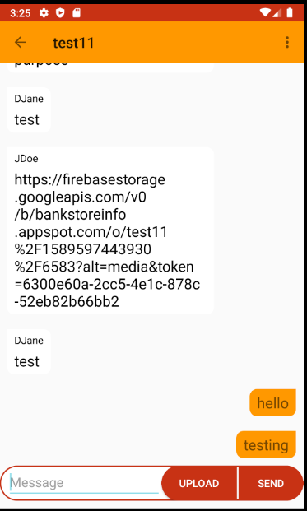
Chat Screen
The Chat screen is the main feature of the application which allows for the sharing of messages and files.
The major functionality of the page would be :
Send Message
Maps
File Sharing
Notes:
When a user has been logged in and selects a chat this is the welcome page. This page shows all the messages sent in this specific chat room as well as the appropriate media links and map coordinates. This is the main purpose and functionality of the map allowing for the sharing of different ideas and media between a large user base. By having links to external sites and automatically recognizing download links to make accessing files easier the app becomes an in-depth communication tool for its users.

Slide 22
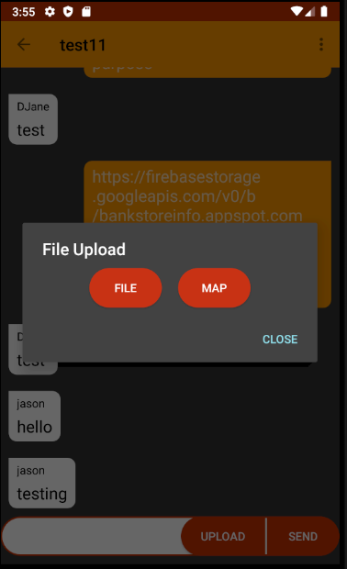
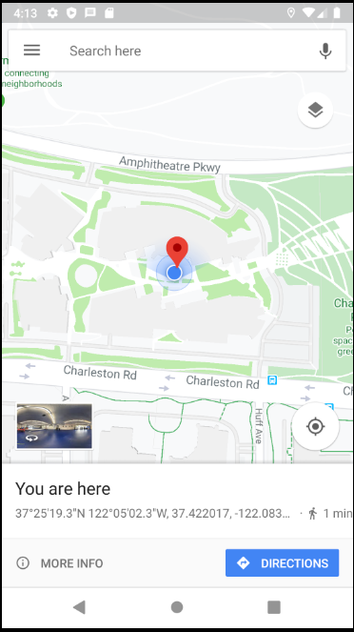
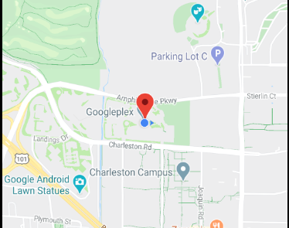
Map Screen
This is screen allows for the users to be able to share locations or meeting points with in the application where they can send ether google maps url links or coordinate links
Notes:
Maps can be accessed by clicking the upload button. The user will then be shown a dialog box where they can choose from either file or maps. If maps is chosen, the user will then be brought to the map application. From here, users are able to create pins and to retrieve their coordinates and URL links .

Slide 23
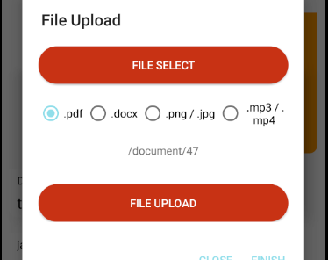
File Sharing
This is Screen allows for the user to upload download file links into a specified chat that was selected before
Notes:
This screen allows for the sharing of different files inside of a specified chat. To share files, the user must firstly click the upload button and then file. The user will then be given a dialog for selecting and uploading file. When file select is clicked, the user will then be shown their file manager where they are able to select a file from their local storage. Afterwards they will be directed back to the application. When “file” is selected, they can upload the file, when the button is clicked a progress bar will be displayed and turn red when complete. When the file has been uploaded and upon return to the chat, the download link for the application would have been sent in chat.

Slide 24
File Sharing

Slide 25
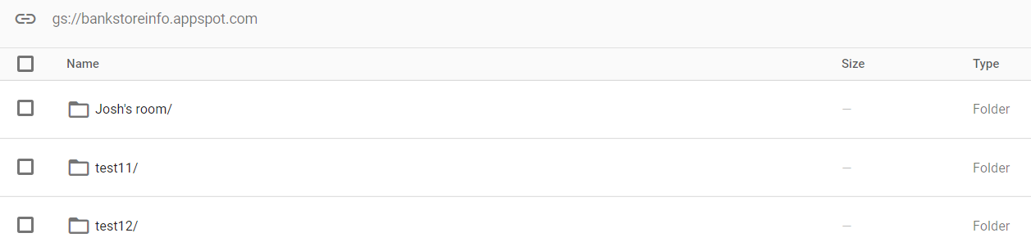
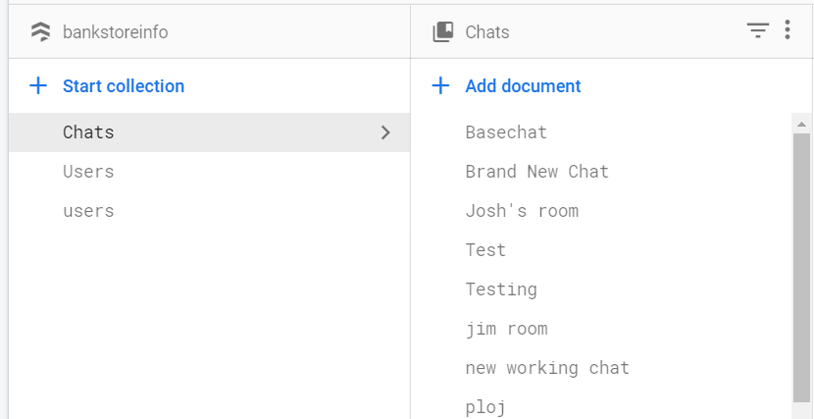
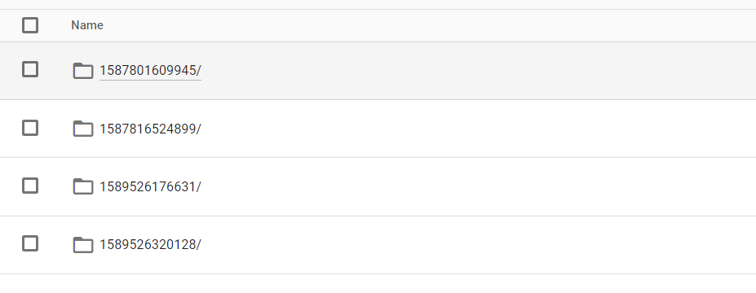
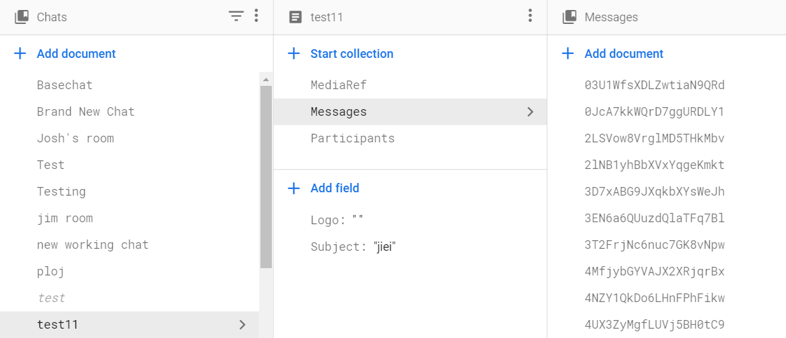
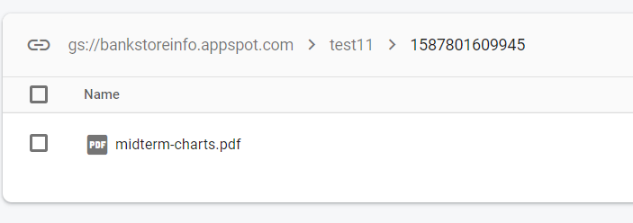
Backend
Notes:
The backend is the backbone of the application. The backend stores user data , as well as the chat messages and finally, file storage.
The application uses Firebase’s “Firestore” to allow for storing messages and data on the cloud as well as being able to reference it.
As an online storage media, the application uses Firebase storage. This allows for the storing of files online as well as the creation of external download links, facilitating the file sharing and automatic download capabilities of the application

Slide 26
Conclusion
Notes:
We aimed to have an app which if it was put on to the phones of the entire class we would be able to communicate with each not only on the same network but any where in the region
To stimulate conversation and critical thinking and to make it a simple and safe way of communication
From the current iteration of the application we are well on the way to have the application reach the stage where it won't be limited to only regional use and support hundreds of users

Slide 27
Questions
Please Ask Any Questions
All Questions Are welcome
I look forward to furthering your understanding of the application

Slide 28
THANK YOU

